Slide 1
nota•bene
Final Demo
Group 1 (A2)
CSE 326 - Information System Design

Slide 2
BPMN Diagram

Slide 3
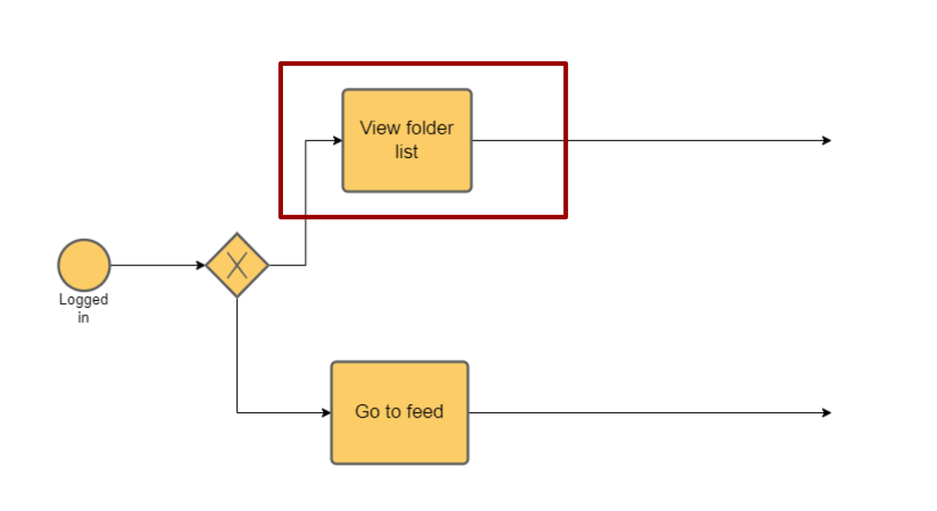
Relevant BPMN Diagrams

Slide 4
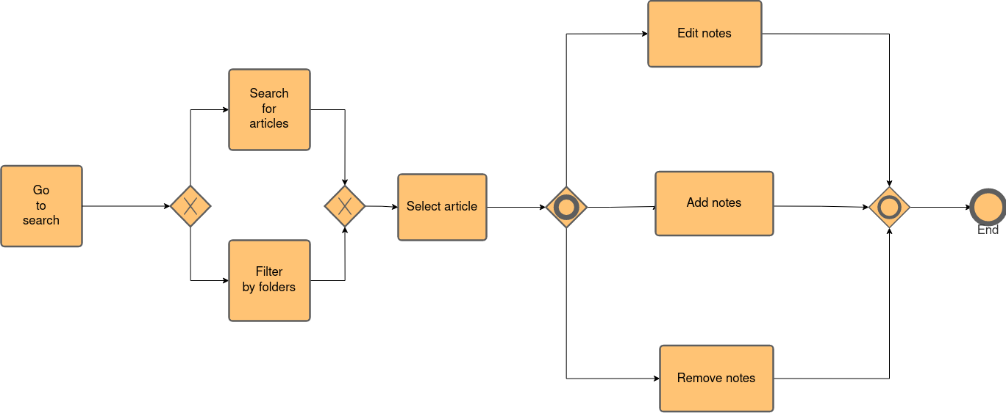
Relevant BPMN Diagrams

Slide 5
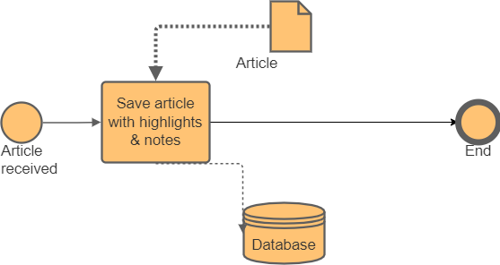
Relevant BPMN Diagrams

Slide 6
Mock UI

Slide 7
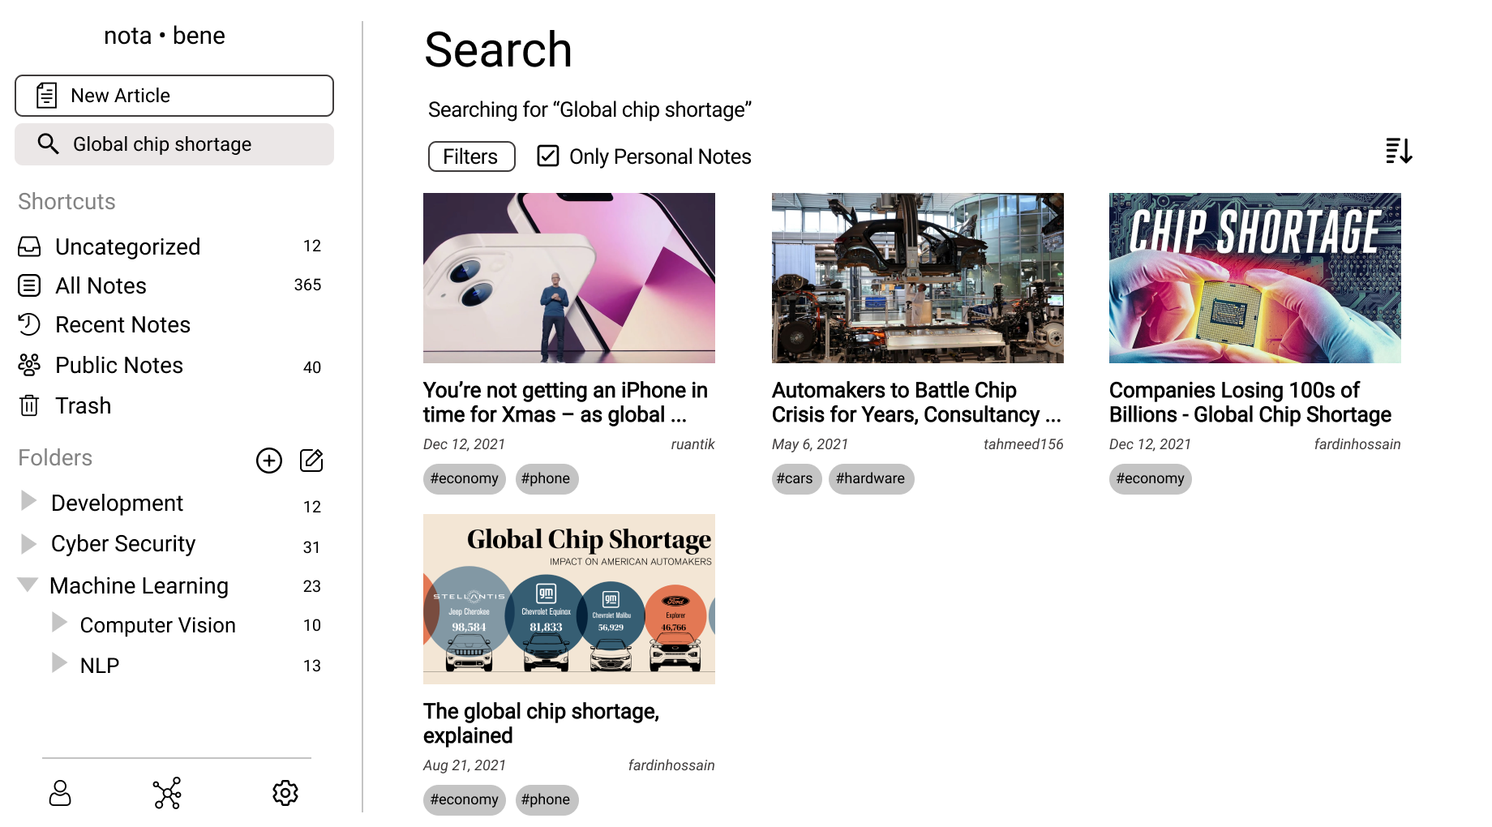
Mock UI

Slide 8
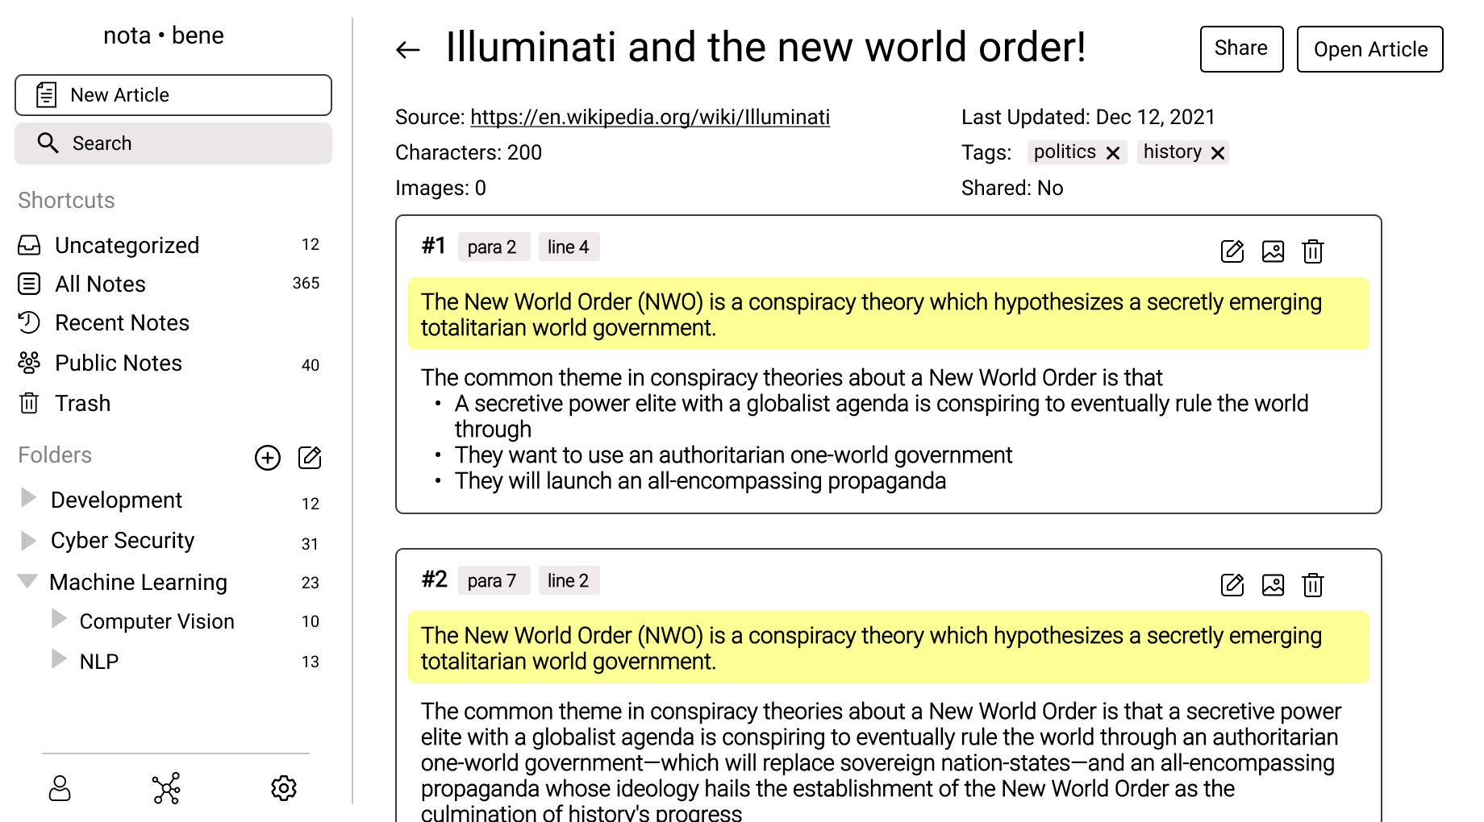
Mock UI

Slide 9
ERD

Slide 10
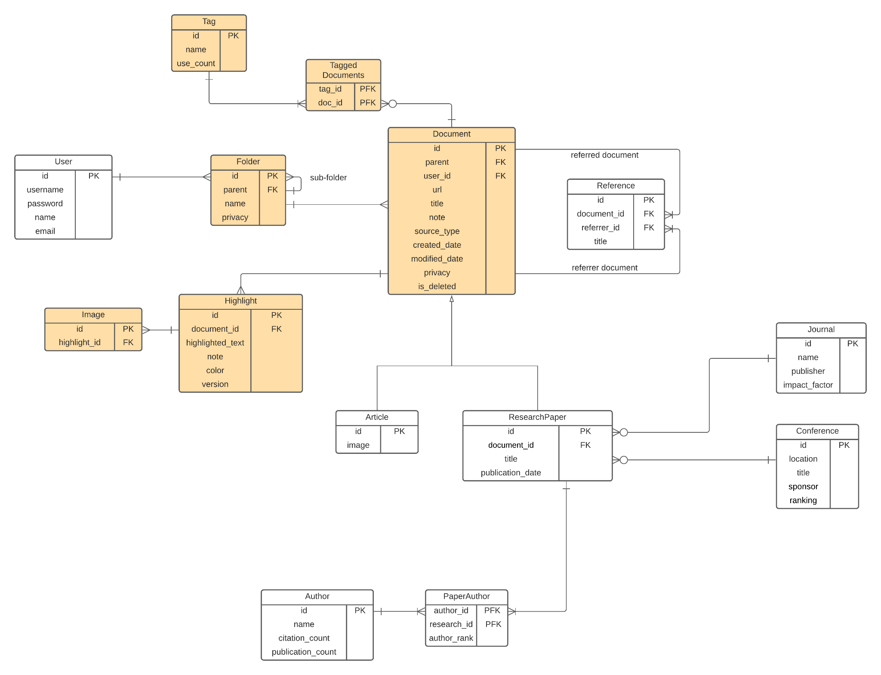
Relevant ERD

Slide 11
Sequence Diagram

Slide 12
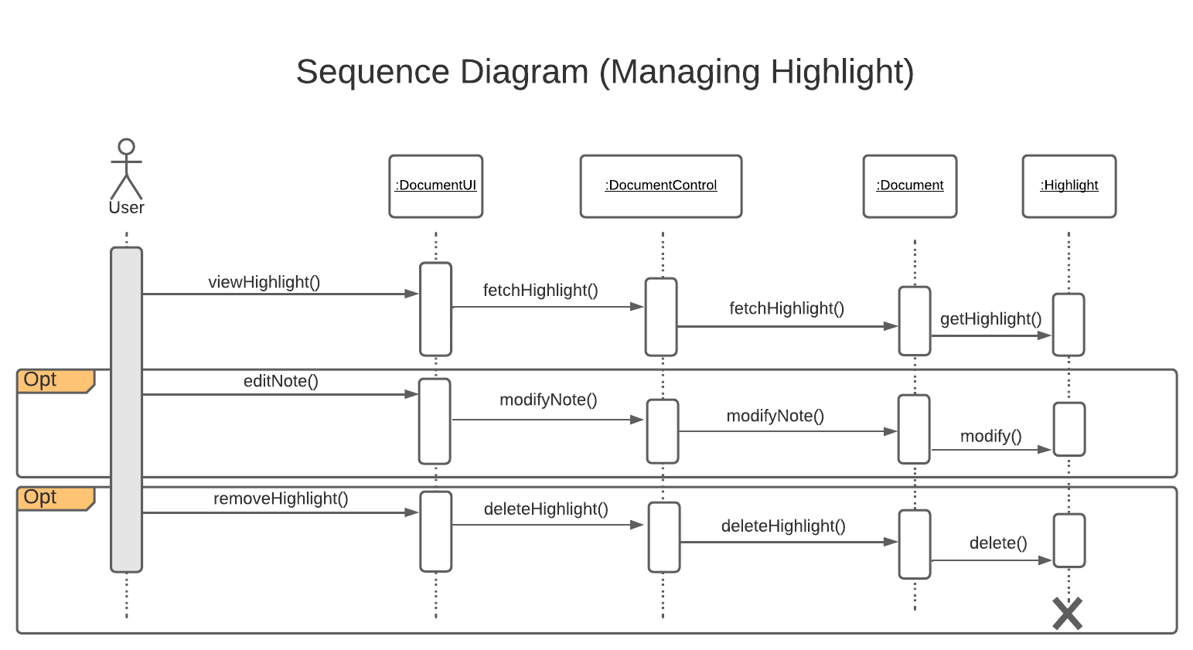
Relevant Portion in Sequence Diagram

Slide 13
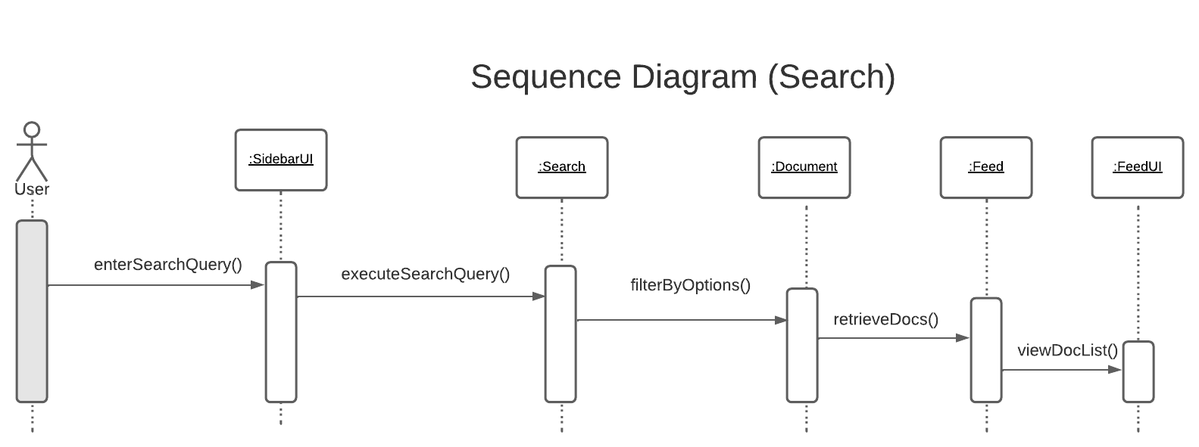
Relevant Portion in Sequence Diagram

Slide 14
Collaboration Diagram

Slide 15
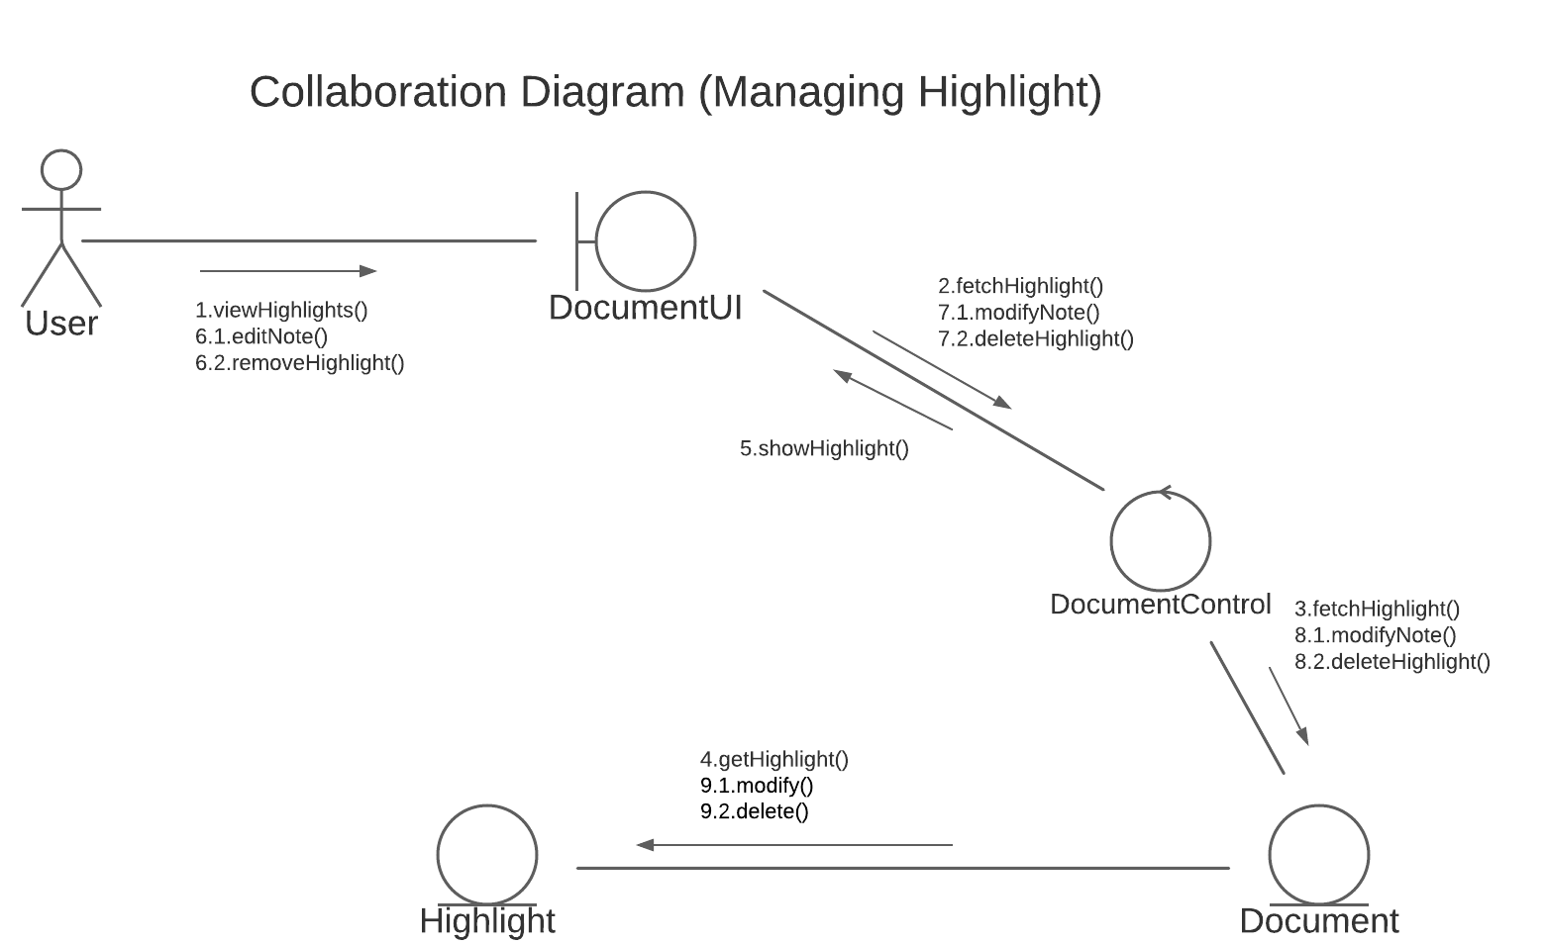
Relevant Collaboration Diagram

Slide 16
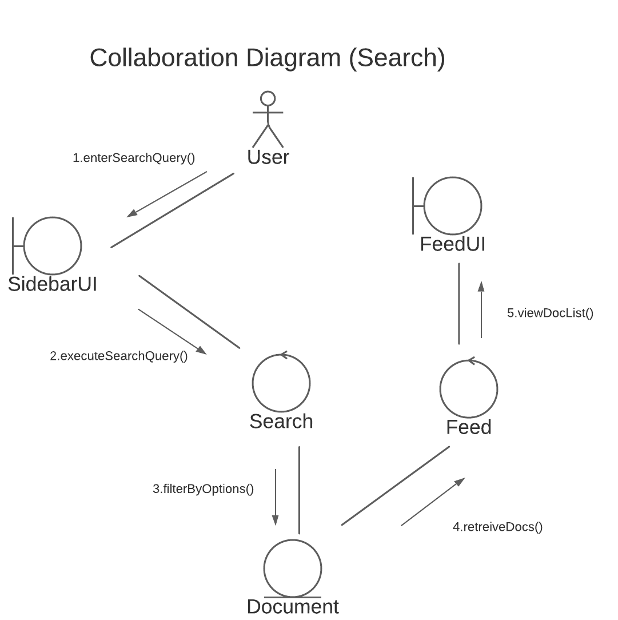
Relevant Collaboration Diagram

Slide 17
Class Diagram

Slide 18
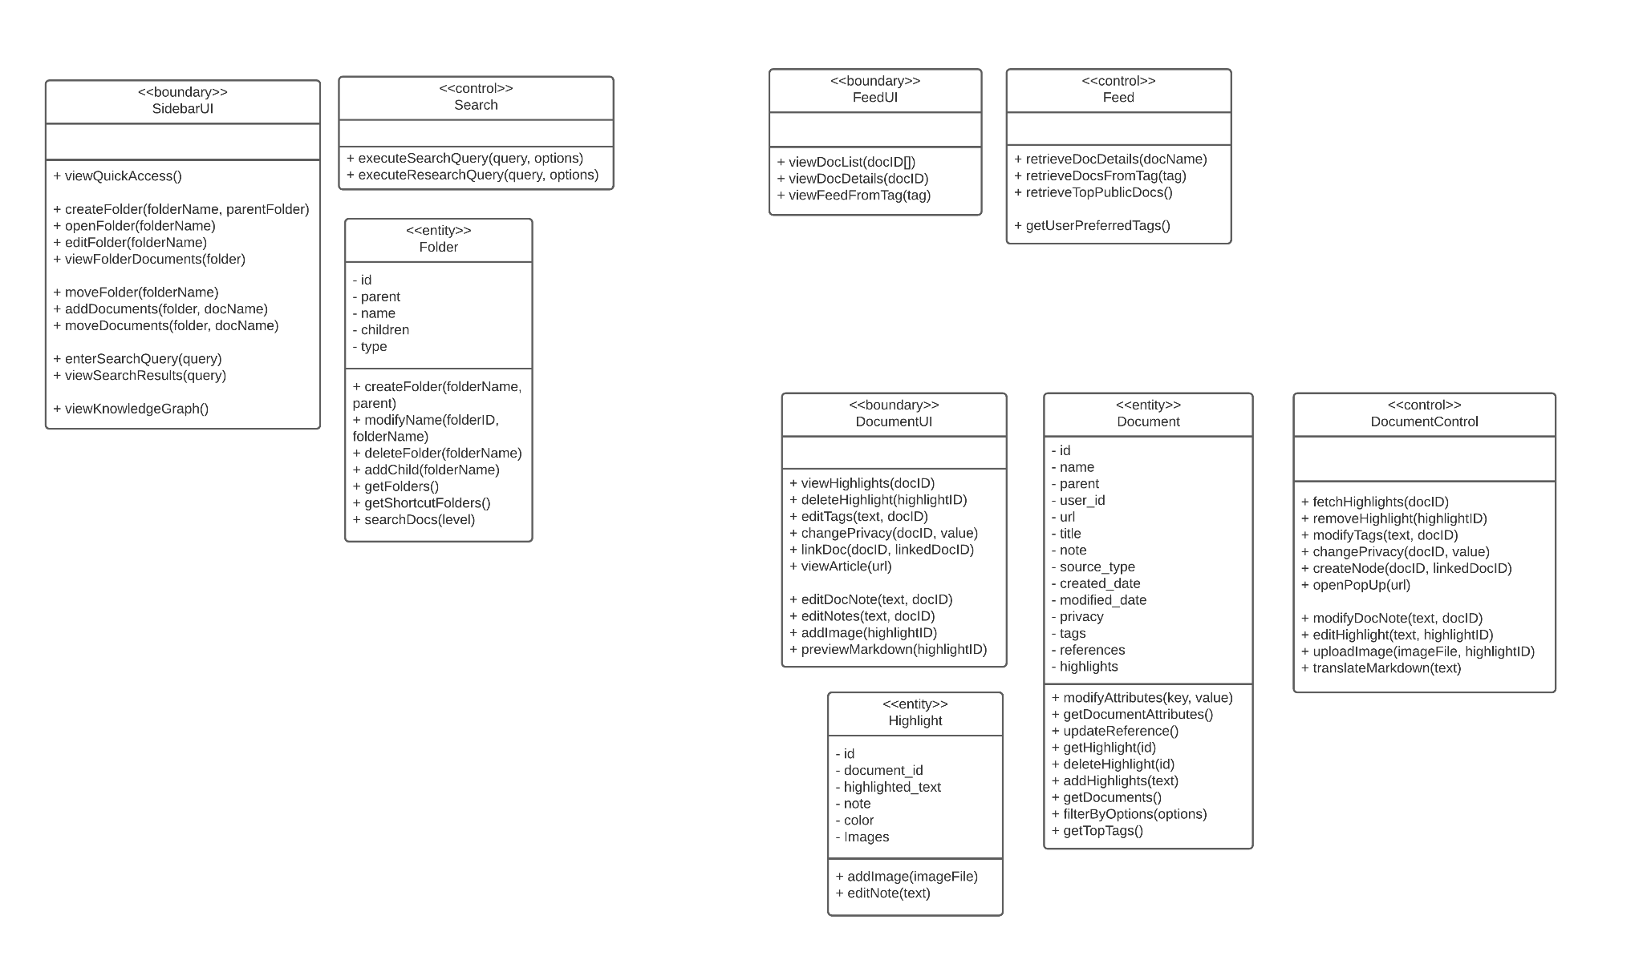
Relevant Class Diagram

